Slide 1


WEB APPLICATION
404 NOT FOUND: YOUR APP'S SECURITY HAS BEEN BREACHED

Slide 2

WHAT IS CYBERSECURITY?
LEARN
Cybersecurity is all about protecting things in the digital world from attacks.
People who try to steal information, cause damage, or disrupt things with cyberattacks are called cyber criminals.
Cybersecurity aims to stop them from being successful.
The Most Precious thing to save is USER DATA
PRESENTATION

Slide 3
WHAT IS WEB APPLICATION?
Are Websites and Web Applications Same?
Web Application is a special website that can perform more complex functions than just displaying information.
LEARN
The web application software resides on a remote server and is delivered to your device whenever you access it through your browser.
Web applications are a powerful and convenient way to access software and services online. They offer a variety of benefits for both businesses and individuals
PRESENTATION

Slide 4
WHAT ARE HEADERS IN WEB APP?
Headers in web applications are essentially little envelopes containing additional information exchanged between a web browser (client) and a web server
Request Headers: These are sent by the client (browser) to the server.
Response Headers: These are sent by the server back to the client (browser).
Security headers are also included in response headers to help protect the application from various attacks.
PRESENTATION

Slide 5
SECURITY HEADERS
Strict-Transport-Security (HSTS): This header enforces HTTPS connections for a website.
Content-Security-Policy (CSP): This powerful header restricts where the browser can load resources (scripts, images, stylesheets) from.
X-Frame-Options: This header prevents a website from being loaded within a frame (iframe) of another website.
X-Content-Type-Options: This header prevents browsers from MIME sniffing, a technique attackers can use to inject malicious code.
PRESENTATION

Slide 6
MINDSET WHILE TESTING
Don’t Test to find something in the web application.
Keep Your Eyes open to notice any Unusual Working of the Application.
To understand better what are the important factors used in order to perform activity in the application.
Always see the application from the perspective of a malicious actor.
a tiny detail can expose a significant security weakness.
PRESENTATION

Slide 7
FIRST STEP BEFORE STARTING PENTEST
Understand the business of the web application.
Understand how the server responds on every request.
Understand the data at stake. It will help determine your testing and reporting methodology.
Gather as much information of the target as possible.
PRESENTATION

Slide 8

TWO IMPORTANT QUESTIONS IN CYBERSECURITY
HOW?
Always ask How any function is working to yourself.
If the server is responding. How is it responding.
WHY?
If anything is happening while testing always ask why to yourself.
If you send <script>alert()</script> as your name in the form and you can see alert. Why does the alert came.
always be curious while testing

Slide 9


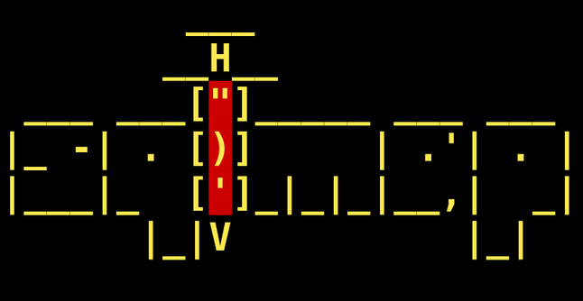


TOOLS WE WILL USE
nOTE: tHE TOOLS WONT BE LIMITED TO THESE

Slide 10
TWO IMPORTANT METHODS OF PENTESTING
BLACK BOX PENTESTING
Mimics a real-world external attacker.
The tester starts with zero knowledge about the system.
GRAY BOX PENETRATION TESTING
Simulates an attacker with some insider knowledge.
Limited internal information. This could include:
Low-level user credentials.
Application logic flowcharts.
Basic network infrastructure maps.

Slide 11

WHAT DO WE MEAN BY VULNERABILITIES.
A vulnerability refers to a weakness in a computer system, network, or application that can be exploited by a malicious actor to gain unauthorized access, cause damage, or steal data.

Slide 12
XSS (CROSS-SITE SCRIPTING ATTACKS.)
Imagine a fake message hidden inside a website. When you visit the site, the fake message tricks the site and pops up. Attackers use this to steal your info or mess with the website. Be careful what you enter online!
When the malicious code executes inside a victim's browser, the attacker can fully compromise their interaction with the application.
XSS is a client side vulnerability
This Works on Javascript.

Slide 13
TYPES OF XSS
STORED XSS
Stored XSS (also known as persistent or second-order XSS) arises when an application receives data from an untrusted source and includes that data within its later HTTP responses in an unsafe way.
REFLECTED XSS
Reflected XSS is the simplest variety of cross-site scripting. It arises when an application receives data in an HTTP request and includes that data within the immediate response in an unsafe way.
DOM BASED XSS
DOM-based XSS (also known as DOM XSS) arises when an application contains some client-side JavaScript that processes data from an untrusted source in an unsafe way, usually by writing the data back to the DOM.

Slide 14

XSS BASED ATTACKS
Impersonate or masquerade as the victim user.
Carry out any action that the user is able to perform.
Read any data that the user is able to access.
Capture the user's login credentials.
Perform virtual defacement of the web site.

Slide 15
PREVENT XSS INJECTION
Filter input on arrival.
Encode data on output.
Use appropriate response headers.
Content Security Policy.

Slide 16
THANK YOU

